Slide 1
Department of
Computational Intelligence
18AIC302J – WEB PROGRAMMING FOR AI
Course Category : Program Core
Credits : 4
Slot : A
Academic Year : 2024-2025
School of Computing
SRM Institute of Science and Technology
KTR Campus

Slide 2
Course Introduction
Course Objectives
The purpose of learning this course is to:
1. Understand the fundamental elements of HTML CSS to build a web application
2. Learn the fundamentals of client-side validation using JavaScript, jQuery, and AJAX
3. Understand the application of different JavaScript framework
4. Learn the Architecture and development of MVC model using Django
5. Understand the principle and practices for Web Scrapping
and Project
Management
(SEPM)

Slide 3
Unit 1
HTML CSS: Web Fundamentals- Languages for the Web
HTML Basics, HTML Building Blocks
Tables, Forms and its elements
Frames, iFrame
HTML5Controls
CSS and its Types, Box Model
Page Layout, CSS Selectors
Styling Web Page, Responsive Design
CSS Frameworks – Introduction, Bootstrap

Slide 4
Web Programming
Web programming refers to the writing, markup and coding involved in Web development, which includes Web content, Web client and server scripting and network security.
The most common languages used for Web programming are XML, HTML, JavaScript, Perl 5 and PHP.
Web programming is different from just programming, which requires interdisciplinary knowledge on the application area, client and server scripting, and database technology.

Slide 5
What is HTML?
HTML (Hypertext Markup Language) is the only markup language for creating web pages. It provides some titles, headings, paragraphs, lists, tables, embedded images, etc., to describe the structure of text-based and multimedia information in HTML documents.
Here is some key information to easily describe HTML:
HTML (Hypertext Markup Language) is a language for publishing text-based and multimedia information on the World Wide Web.
HTML is a straightforward Computer Coding Language. It was developed in the 90’s. HTML is the basis of a web page, and the web page is the basis of a website. HTML uses 'tags' to create web documents.
HTML is a hypertext markup language, a predetermined set of markup tags used to design web pages.
HTML is the first language of web designing. CSS is also used along with HTML to improve web page design further. JavaScript is used with HTML to make web pages dynamic.
HTML is relatively easy to learn because every tag is predefined, so only we need to know the work of tags and their attributes.
Web browsers (Chrome, Internet Explorer, Firefox, Safari, and other web browsers) are software' to read HTML and display web page design as output.
You can write HTML in any simple editor, such as Notepad. And other software, such as Adobe Dreamweaver, Sublime, NetBeans, Notepad ++, etc., are mainly used for writing and editing HTML.
".html" or ".htm" are the two extensions used to write and save HTML files; we can write HTML code in any text editor and save it as "filename.html" or "filename.htm ".

Slide 6
HTML stands for Hyper Text Markup Language
HTML is the standard markup language for creating Web pages
HTML describes the structure of a Web page
HTML consists of a series of elements
HTML elements tell the browser how to display the content
HTML elements label pieces of content such as "this is a heading", "this is a paragraph", "this is a link", etc.

Slide 7
HTML HISTORY
HTML was created by Sir Tim Berners-Lee in late 1991 but was not officially released. It was published in 1995 as HTML 2.0. HTML 4.01 was published in late 1999 and was a major version of HTML.
HTML is a very evolving markup language and has evolved with various versions updating. Long before its revised standards and specifications are carried in, each version has allowed its user to create web pages in a much easier and prettier way and make sites very efficient.
HTML 1.0 was released in 1993 with the intention of sharing information that can be readable and accessible via web browsers. But not many of the developers were involved in creating websites. So the language was also not growing.
Then comes HTML 2.0, published in 1995, which contains all the features of HTML 1.0 along with a few additional features, which remained the standard markup language for designing and creating websites until January 1997 and refined various core features of HTML.
Then comes HTML 3.0, where Dave Raggett introduced a fresh paper or draft on HTML. It included improved new features of HTML, giving more powerful characteristics for webmasters in designing web pages. But these powerful features of the new HTML slowed down the browser in applying further improvements.
Then comes HTML 4.01, which is widely used and was a successful version of HTML before HTML 5.0, which is currently released and used worldwide. HTML 5 can be said for an extended version of HTML 4.01, which was published in the year 2012.

Slide 8
Versions of HTML
Let's see the list of different versions of HTML with their timeline and features.
1991 - Tim Berners-Lee created HTML 1.0
1993:-
HTML 1.0 was first released in 1993 for developers
back then not many developers were creating websites so it was evolving slowly during those time
This version only had basic tags like text, even tables and fonts were not available in this version
Nov 24, 1995 - This year HTML 2.0 was published. All the features of HTML 1.0 were inherited in HTML 2.0 plus new features were added. Until the release of HTML 3.0, it remains the standard markup language for creating websites.
Jan 14, 1997:-
HTML 3.2 was published in 1997 as W3C Recommendation
It was the first version of HTML which was developed by W3C
In this version, there was good support for form elements
One most important thing that was added in this version was the support of CSS
1999:-
HTML 4.01 was published as W3C Recommendation on Dec 14, 1999
This version was the most successful of all previous HTML released versions
In this version features like multimedia, scripting, better printing features and more were added.
After the release of HTML 4.01, no newer version of HTML was released for many years because W3C's HTML working group were busy building the language XHTML
2014:-
HTML5 (the latest version of HTML) was released on Oct 28, 2014 as W3C Recommendation
It was an extended version of HTML 4.01 published in 2012
Many new tags were added in this version like <header>, <footer>, <main>, <video>, etc.
HTML5 support mathML and SVG in text.

Slide 9
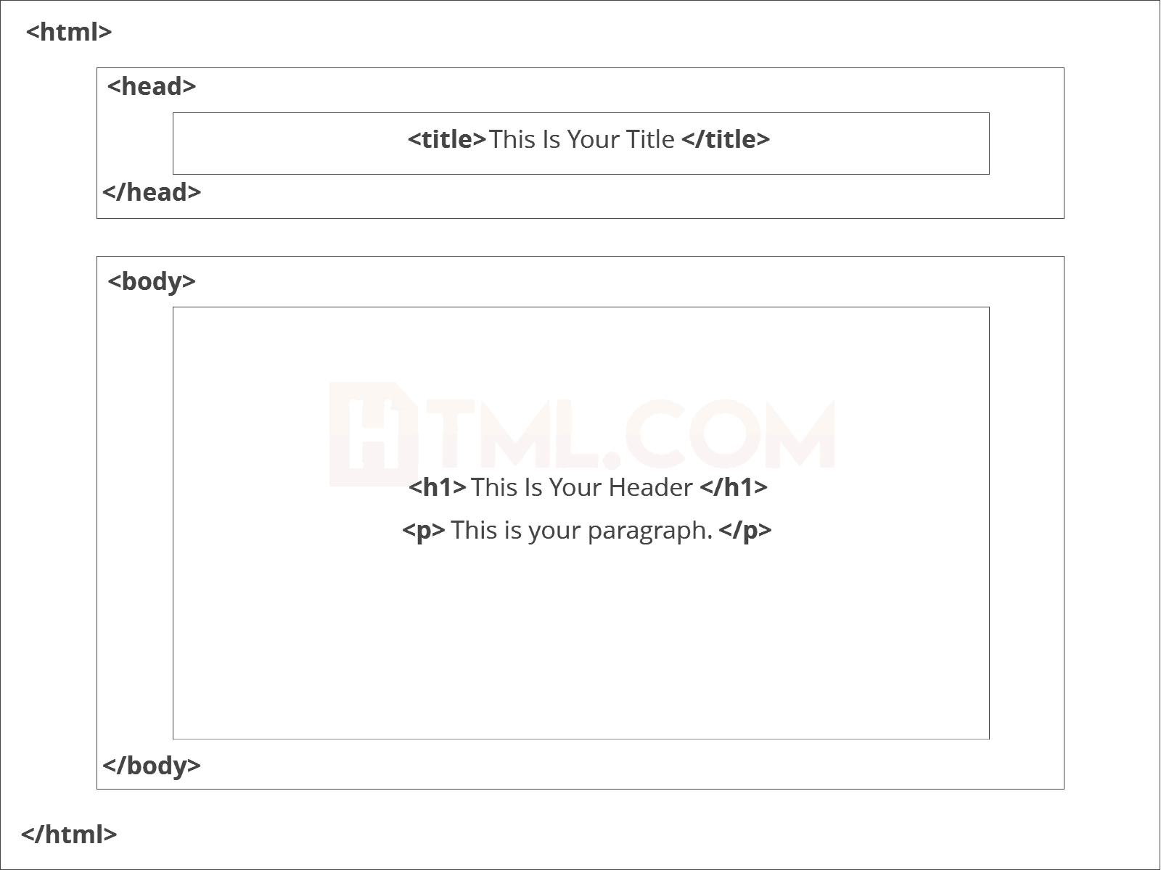
Basic Construction of an HTML Page
These tags should be placed underneath each other at the top of every HTML page that you create.
<!DOCTYPE html> — This tag specifies the language you will write on the page. In this case, the language is HTML 5.
<html> — This tag signals that from here on we are going to write in HTML code.
<head> — This is where all the metadata for the page goes — stuff mostly meant for search engines and other computer programs.
<title> - This tag specifies a title for the HTML page (which is shown in the browser's title bar or in the page's tab)
<body> — This is where the content of the page goes.

Slide 10
HTML Editors
HTML Using Notepad or TextEdit
Web pages can be created and modified by using professional HTML editors.
However, for learning HTML we recommend a simple text editor like Notepad (PC) or TextEdit (Mac).
We believe that using a simple text editor is a good way to learn HTML.
Follow the steps below to create your first web page with Notepad or TextEdit.
Step 1: Open Notepad (Windows PC)
Windows 8 or later:
Open the Start Screen (the window symbol at the bottom left on your screen). Type Notepad.
Windows 7 or earlier:
Open Start > Programs > Accessories > Notepad
Step 1: Open TextEdit (Mac)
Open Finder > Applications > TextEdit
Also change some preferences to get the application to save files correctly. In Preferences > Format > choose "Plain Text"
Then under "Open and Save", check the box that says "Display HTML files as HTML code instead of formatted text".
Then open a new document to place the code.

Slide 11
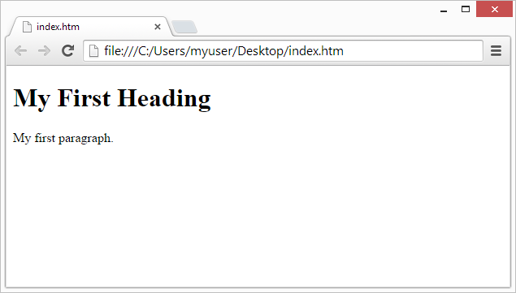
Step 2: Write Some HTML
Write or copy the following HTML code into Notepad:
<!DOCTYPE html> <html> <head> <title> Sample Program </title>
<body> <h1>My First Heading</h1> <p>My first paragraph</p> </body> </html>
Step 3: Save the HTML Page
Save the file on your computer. Select File > Save as in the Notepad menu.
Name the file "index.htm" and set the encoding to UTF-8 (which is the preferred encoding for HTML files).
Step 4: View the HTML Page in Your Browser
Open the saved HTML file in your favourite browser (double click on the file, or right-click - and choose "Open with").

Slide 12
The <!DOCTYPE> Declaration
The <!DOCTYPE> declaration represents the document type, and helps browsers to display web pages correctly.
It must only appear once, at the top of the page (before any HTML tags).
The <!DOCTYPE> declaration is not case sensitive.
The <!DOCTYPE> declaration for HTML5 is:
<!DOCTYPE html>
Example Program:
<!DOCTYPE html>
<html>
<head>
<title>Page Title</title>
</head>
<body>
<h1>My First Heading</h1>
<p>My first paragraph.</p>
</body>
</html>

Slide 13
Features of HTML
1) It is a very easy and simple language. It can be easily understood and modified.
2) It is very easy to make an effective presentation with HTML because it has a lot of formatting tags.
3) It is a markup language, so it provides a flexible way to design web pages along with the text.
4) It facilitates programmers to add a link on the web pages (by html anchor tag), so it enhances the interest of browsing of the user.
5) It is platform-independent because it can be displayed on any platform like Windows, Linux, and Macintosh, etc.
6) It facilitates the programmer to add Graphics, Videos, and Sound to the web pages which makes it more attractive and interactive.
7) HTML is a case-insensitive language, which means we can use tags either in lower-case or upper-case.

Slide 14
HTML | HTML5
It didn’t support audio and video without the use of flash player support. | It supports audio and video controls with the use of <audio> and <video> tags.
It uses cookies to store temporary data. | It uses SQL databases and application cache to store offline data.
Does not allow JavaScript to run in browser. | Allows JavaScript to run in background. This is possible due to JS Web worker API in HTML5.
Vector graphics is possible in HTML with the help of various technologies such as VML, Silver-light, Flash, etc. | Vector graphics is additionally an integral a part of HTML5 like SVG and canvas.
It does not allow drag and drop effects. | It allows drag and drop effects.
Not possible to draw shapes like circle, rectangle, triangle etc. | HTML5 allows to draw shapes like circle, rectangle, triangle etc.
It works with all old browsers. | It supported by all new browser like Firefox, Mozilla, Chrome, Safari, etc.
<HTML>,<Body> , and <Head> tags are mandatory while writing a HTML code. | These tags can be omitted while writing HTML code.
Older version of HTML are less mobile-friendly. | HTML5 language is more mobile-friendly.
Doctype declaration is too long and complicated. | Doctype declaration is quite simple and easy.
Elements like nav, header were not present. | New element for web structure like nav, header, footer etc.
Character encoding is long and complicated. | Character encoding is simple and easy.
It is almost impossible to get true GeoLocation of user with the help of browser. | One can track the GeoLocation of a user easily by using JS GeoLocation API.
It can not handle inaccurate syntax. | It is capable of handling inaccurate syntax.
Being an older version , it is not fast , flexible , and efficient as compared to HTML5. | It is efficient, flexible and more fast in comparison to HTML.
Attributes like charset, async and ping are absent in HTML. | Attributes of charset, async and ping are a part of HTML 5.

Slide 15
HTML Elements
What is an HTML Element?
An HTML element is defined by a start tag, some content, and an end tag:
<tagname> Content goes here... </tagname>
Example:
The HTML element is everything from the start tag to the end tag:
<h1>My First Heading</h1>
<p>My first paragraph.</p>
Nested HTML Elements
HTML elements can be nested (this means that elements can contain other elements).
All HTML documents consist of nested HTML elements.
The following example contains four HTML elements (<html>, <body>, <h1> and <p>):
<!DOCTYPE html> <html> <body> <h1>My First Heading</h1> <p>My first paragraph.</p> </body> </html>

Slide 16
Example:
HTML Block and Inline Elements
Every HTML element has a default display value, depending on what type of element it is.
There are two display values: block and inline.
Block-level Elements
A block-level element always starts on a new line, and the browsers automatically add some space (a margin) before and after the element.
A block-level element always takes up the full width available (stretches out to the left and right as far as it can).
Two commonly used block elements are: <p> and <div>.
The <p> element defines a paragraph in an HTML document.
The <div> element defines a division or a section in an HTML document.
<!DOCTYPE html>
<html>
<body>
<p style="border: 1px solid black">Hello World</p>
<div style="border: 1px solid black">Hello World</div>
<p>The P and the DIV elements are both block elements, and they will always start on a new line and take up the full width available (stretches out to the left and right as far as it can).</p>
</body>
</html>

Slide 17
Inline Elements
An inline element does not start on a new line.
An inline element only takes up as much width as necessary.
This is a <span> element inside a paragraph.
<!DOCTYPE html>
<html>
<body>
<p>This is an inline span <span style="border: 1px solid black">Hello World</span> element inside a paragraph.</p>
<p>The SPAN element is an inline element, and will not start on a new line and only takes up as much width as necessary.</p>
</body>
</html>
Here are the inline elements in HTML:
<a>
<abbr>
<acronym>
<b>

Slide 18
HTML Basic Examples
The basic elements of an HTML page are:
A text header, denoted using the <h1>, <h2>, <h3>, <h4>, <h5>, <h6> tags.
A paragraph, denoted using the <p> tag.
A horizontal ruler, denoted using the <hr> tag.
A link, denoted using the <a> (anchor) tag.
A list, denoted using the <ul> (unordered list), <ol> (ordered list) and <li> (list element) tags.
An image, denoted using the <img> tag
A divider, denoted using the <div> tag
A text span, denoted using the <span> tag

Slide 19
HTML Headings: These tags help us to give headings to the content of a webpage. These tags are mainly written inside the body tag. HTML provides us with six heading tags from <h1> to <h6>. Every tag displays the heading in a different style and font size.
Most HTML heading tag that we use :-
Heading 1
Heading 2
Heading 3
Heading 4
Heading 5
Heading 6
HTML Paragraph: These tags help us to write paragraph statements on a webpage. They start with the <p> tag and ends with </p>.
HTML Break: These tags are used for inserting a single line type break. It does not have any closing tag. In HTML the break tag is written as <br>.
HTML Horizontal Line: The <hr> tag is used to break the page into various parts, creating horizontal margins with help of a horizontal line running from the left to right-hand side of the page. This is also an empty tag and doesn’t take any additional statements.
HTML Images: The image tag is used to insert an image into our web page. The source of the image to be inserted is put inside the <img src=”source_of_image“> tag.
Image can be inserted in the image tag in two formats: –
If the image is in the same folder, then we can just write the name of the image and the format as the path.
If the image is in another folder, then we do need to mention the path of the image and the image name as well as the format of the image.

Slide 20
Difference between HTML div tag and span tag
Div Tag: Div tag has both open(<div>) and closing (</div>) tag and it is mandatory to close the tag. The Div is the most usable tag in web development because it helps us to separate out data in the web page and we can create a particular section for particular data or function in the web pages.
The span tag is a paired tag means it has both open(<) and closing (>) tags, and it is mandatory to close the tag. The span tag is used for the grouping of inline elements & this tag does not make any visual change by itself. span is very similar to the div tag, but div is a block-level tag and span is an inline tag.
div tag | span tag
HTML div is a block element. | HTML span is an inline element
HTML div element is used to wrap large sections of elements. | HTML span element is used to wrap small portion of texts, image etc.

Slide 21
Lists Tag:
HTML Lists are used to specify lists of information. All lists may contain one or more list elements. There are three different types of HTML lists:
Ordered List or Numbered List (ol)
Unordered List or Bulleted List (ul)
Description List or Definition List (dl)
HTML Ordered List or Numbered List
In the ordered HTML lists, all the list items are marked with numbers by default. It is known as numbered list also. The ordered list starts with <ol> tag and the list items start with <li> tag.
The type Attribute
You can use type attribute for <ol> tag to specify the type of numbering you like. By default, it is a number. Following are the possible options −
<ol type = "1"> - Default-Case Numerals.
<ol type = "I"> - Upper-Case Numerals.
<ol type = "i"> - Lower-Case Numerals.
<ol type = "A"> - Upper-Case Letters.
<ol type = "a"> - Lower-Case Letters.
The start Attribute
You can use start attribute for <ol> tag to specify the starting point of numbering you need. Following are the possible options −
<ol type = "1" start = "4"> - Numerals starts with 4.
<ol type = "I" start = "4"> - Numerals starts with IV.
<ol type = "i" start = "4"> - Numerals starts with iv.
<ol type = "a" start = "4"> - Letters starts with d.
<ol type = "A" start = "4"> - Letters starts with D.

Slide 22
HTML Unordered List or Bulleted List
In HTML Unordered list, all the list items are marked with bullets. It is also known as bulleted list also. The Unordered list starts with <ul> tag and list items start with the <li> tag.
The type Attribute
You can use type attribute for <ul> tag to specify the type of bullet you like. By default, it is a disc. Following are the possible options −
<ul type = "square">
<ul type = "disc">
<ul type = "circle">
HTML Description List or Definition List
HTML Description list is also a list style which is supported by HTML and XHTML. It is also known as definition list where entries are listed like a dictionary or encyclopedia.
The definition list is very appropriate when you want to present glossary, list of terms or other name-value list.
The HTML definition list contains following three tags:
<dl> tag defines the start of the list.
<dt> tag defines a term.
<dd> tag defines the term definition (description).

Slide 23
HTML Tables
The HTML tables allow web authors to arrange data like text, images, links, other tables, etc. into rows and columns of cells.
The HTML tables are created using the <table> tag in which the <tr> tag is used to create table rows and <td> tag is used to create data cells. The elements under <td> are regular and left aligned by default.
Table Heading
Table heading can be defined using <th> tag. This tag will be put to replace <td> tag, which is used to represent actual data cell.
Cellpadding and Cellspacing Attributes
There are two attributes called cellpadding and cellspacing which you will use to adjust the white space in your table cells. The cellspacing attribute defines space between table cells, while cellpadding represents the distance between cell borders and the content within a cell.
Colspan and Rowspan Attributes
You will use colspan attribute if you want to merge two or more columns into a single column. Similar way you will use rowspan if you want to merge two or more rows.
Tables Backgrounds
You can set table background using one of the following two ways −
bgcolor attribute − You can set background color for whole table or just for one cell.
background attribute − You can set background image for whole table or just for one cell.

Slide 24
Table Height and Width
You can set a table width and height using width and height attributes. You can specify table width or height in terms of pixels or in terms of percentage of available screen area.
Table Caption
The caption tag will serve as a title or explanation for the table and it shows up at the top of the table. This tag is deprecated in newer version of HTML/XHTML.

Slide 25
HTML Formatting is a process of formatting text for better look and feel. HTML provides us ability to format text without using CSS. There are many formatting tags in HTML. These tags are used to make text bold, italicized, or underlined. There are almost 14 options available that how text appears in HTML and XHTML. In HTML the formatting tags are divided into two categories: Physical tag: These tags are used to provide the visual appearance to the text. Logical tag: These tags are used to add some logical or semantic value to the text.
HTML Formatting

Slide 26
Element name | Description
<b> | This is a physical tag, which is used to bold the text written between it.
<strong> | This is a logical tag, which tells the browser that the text is important.
<i> | This is a physical tag which is used to make text italic.
<em> | This is a logical tag which is used to display content in italic.
<mark> | This tag is used to highlight text.
<u> | This tag is used to underline text written between it.
<tt> | This tag is used to appear a text in teletype. (not supported in HTML5)
<strike> | This tag is used to draw a strikethrough on a section of text. (Not supported in HTML5)
<sup> | It displays the content slightly above the normal line.
<sub> | It displays the content slightly below the normal line.
<del> | This tag is used to display the deleted content.
<ins> | This tag displays the content which is added
<big> | This tag is used to increase the font size by one conventional unit.
<small> | This tag is used to decrease the font size by one unit from base font size.

Slide 27
HTML Forms
An HTML form is used to collect user input. The user input is most often sent to a server for processing.
The <form> Element
The HTML <form> element is used to create an HTML form for user input:
Syntax:
The <form> element is a container for different types of input elements, such as: text fields, checkboxes, radio buttons, submit buttons, etc.
<form> form elements </form>
The <input> Element
The HTML <input> element is the most used form element.
An <input> element can be displayed in many ways, depending on the type attribute.
Type | Description
<input type="text"> | Displays a single-line text input field
<input type="radio"> | Displays a radio button (for selecting one of many choices)
<input type="checkbox"> | Displays a checkbox (for selecting zero or more of many choices)
<input type="submit"> | Displays a submit button (for submitting the form)
<input type="button"> | Displays a clickable button

Slide 28
Text Fields
The <input type="text"> defines a single-line input field for text input.
The <label> Element
Notice the use of the <label> element in the example above.
The <label> tag defines a label for many form elements.
The <label> element is useful for screen-reader users, because the screen-reader will read out loud the label when the user focus on the input element.
Radio Buttons
The <input type="radio"> defines a radio button.
Radio buttons let a user select ONE of a limited number of choices.
Checkboxes
The <input type="checkbox"> defines a checkbox.
Checkboxes let a user select ZERO or MORE options of a limited number of choices.
The Submit Button
The <input type="submit"> defines a button for submitting the form data to a form-handler.
The form-handler is typically a file on the server with a script for processing input data.
The form-handler is specified in the form's action attribute.

Slide 29
The <select> Element
The <select> element defines a drop-down list:
The <option> elements defines an option that can be selected.
To define a pre-selected option, add the selected attribute to the option
Visible Values:
Use the size attribute to specify the number of visible values
Allow Multiple Selections:
Use the multiple attribute to allow the user to select more than one value
The <textarea> Element
The <textarea> element defines a multi-line input field (a text area)
The rows attribute specifies the visible number of lines in a text area.
The cols attribute specifies the visible width of a text area.
This is how the HTML code above will be displayed in a browse

Slide 30
The <button> Element
The <button> element defines a clickable button
The <fieldset> and <legend> Elements
The <fieldset> element is used to group related data in a form.
The <legend> element defines a caption for the <fieldset> element.
The <datalist> Element
The <datalist> element specifies a list of pre-defined options for an <input> element.
Users will see a drop-down list of the pre-defined options as they input data.
The list attribute of the <input> element, must refer to the id attribute of the <datalist> element.

Slide 31
HTML Form Attributes
The Action Attribute
The action attribute defines the action to be performed when the form is submitted.
Usually, the form data is sent to a file on the server when the user clicks on the submit button.
The Method Attribute
The method attribute specifies the HTTP method to be used when submitting the form data.
The form-data can be sent as URL variables (with method="get") or as HTTP post transaction (with method="post").
The default HTTP method when submitting form data is GET.
The Target Attribute
The target attribute specifies where to display the response that is received after submitting the form.
Value | Description
_blank | The response is displayed in a new window or tab
_self | The response is displayed in the current window
_parent | The response is displayed in the parent frame
_top | The response is displayed in the full body of the window
framename | The response is displayed in a named iframe

Slide 32
GET and POST both are two common HTTP requests used for building REST API’s.
GET requests are used to send only limited amount of data because data is sent into header while POST requests are used to send large amount of data because data is sent in the body.
Post method is secure because data is not visible in URL bar but it is not used as popularly as GET method.
GET is good for non-secure data, like query strings in Google

Slide 33
HTML Frames
HTML Frames are used to divide the web browser window into multiple sections where each section can be loaded separately. A frameset tag is the collection of frames in the browser window.

Slide 34
FRAMES: the HTML tags that divide a browser screen into two or more HTML recognizing unique regions .
Tag used is the <FRAMESET>..</FRAMESET> tags.
Each unique region is called a frame.
Each frame can be loaded with a different document and hence, allow multiple HTML documents to be seen concurrently.

Slide 35
FRAMESET tag: this tag is included after <HEAD> tag . This is a paired tag.
<FRAMESET COLS=“width1,width2, ” ROWS=“height1,height2”>
….. Frame or frameset definitions…..
</FRAMESET>
Cols: this attribute is used for vertical frames and widths are specified as a comma delimited list of sizes in pixels, %age, or as a proportion of the remaining space by using ‘*’.
Rows: this attribute is used for horizontal frames and height again is specified in pixels ,%age or as a proportion of the remaining space by using ‘*’.
Attributes:
Border/ FrameBorder: value 0 will turn off the border and value 1 will turn it on. To increase the border width change the value of border.
bordercolor: to set the frame border color to a specified color.

Slide 36
FRAME: this tag contains the frame content. It tells the browser, what to put in each frame. Each frameset must include a <FRAME> definition for each division. It is a singular tag.
Attributes:
Src: indicates the URL of the document to be loaded into the frame.
MarginHeight: specifies the amount of white space to be left at the top and bottom of the frame.
MarginWidth: specifies the amount of white space to be left along the sides of the frame.
Name: gives the frame a unique name so it can be targeted by other documents. The name given must be given with an alphanumeric character.
Noresize: disables the frame resizing capability.
Scrolling: controls the appearance of horizontal and vertical scrollbars in a frame. This takes the value YES/NO/AUTO.

Slide 37
<html>
<head><title> FRAMING TAGS</title></head>
<frameset cols="50%,50%">
<frame src="form.html">
<frame src="1.html">
</frameset>
</html>

Slide 38
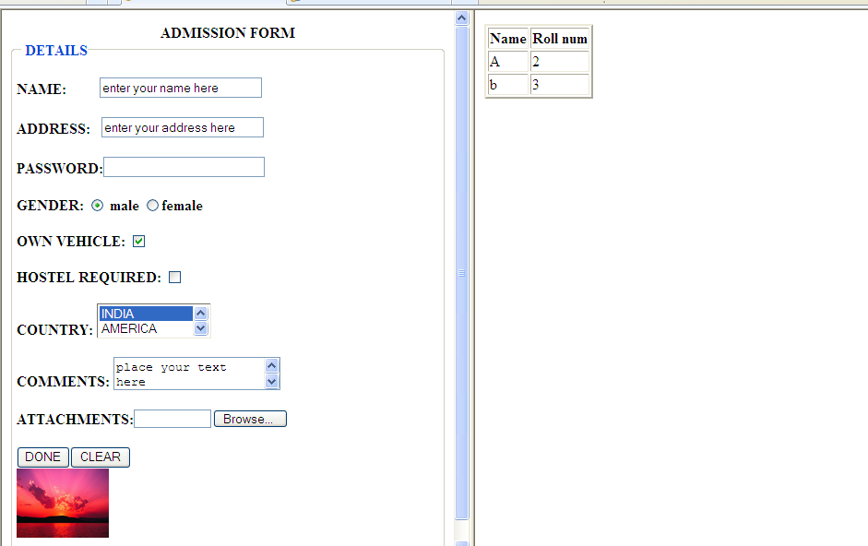

Slide 39
<html>
<head><title> FRAMING TAGS</title></head>
<frameset cols="40%,30%,30%">
<frame src="form.html">
<frame src="1.html">
<frame src="table.html">
</frameset>
</html>

Slide 40
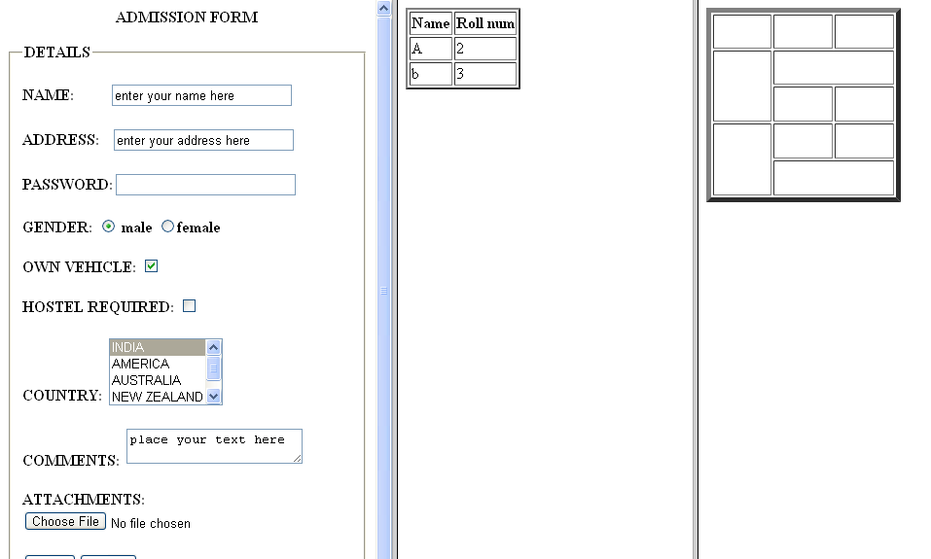

Slide 41
<html>
<head><title> FRAMING TAGS</title></head>
<frameset rows="40%,30%,30%">
<frame src="form.html">
<frame src="1.html">
<frame src="table.html">
</frameset>
</html>

Slide 42
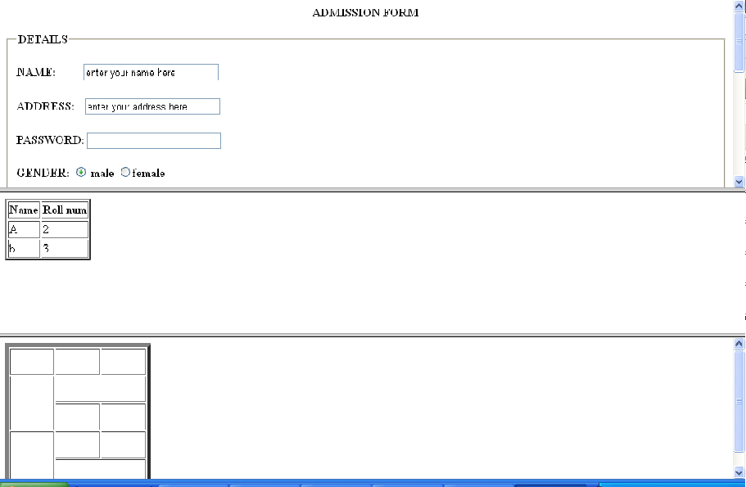

Slide 43
Elastic Frames
The height/ width of frames can be specified in terms of number of pixels. In elastic frames we use the notation * instead of a number. The ‘*’ means whatever is left over.
<html>
<head><title> FRAMING TAGS</title></head>
<frameset rows="200,*,*">
<frame src="form.html">
<frame src="1.html">
<frame src="table.html">
</frameset>
</html>

Slide 44
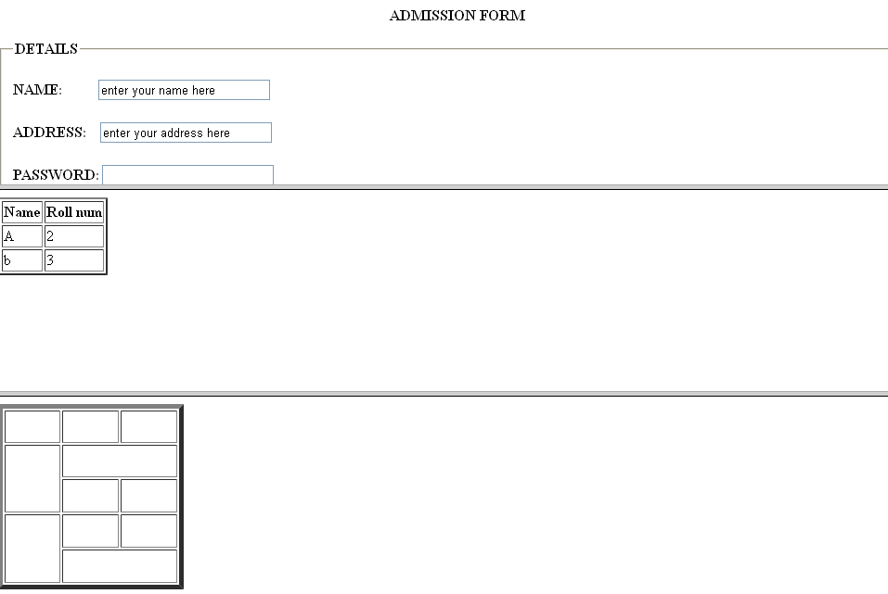

Slide 45
NESTED FRAME SETS
Combinations of rows and columns
<html>
<head><title> FRAMING TAGS</title></head>
<frameset rows="200,*,*">
<frame src="form.html">
<frameset cols="*,*">
<frame src="1.html">
<frame src="table.html">
</frameset>
<frame src="form.html">
</frameset>
</html>

Slide 46
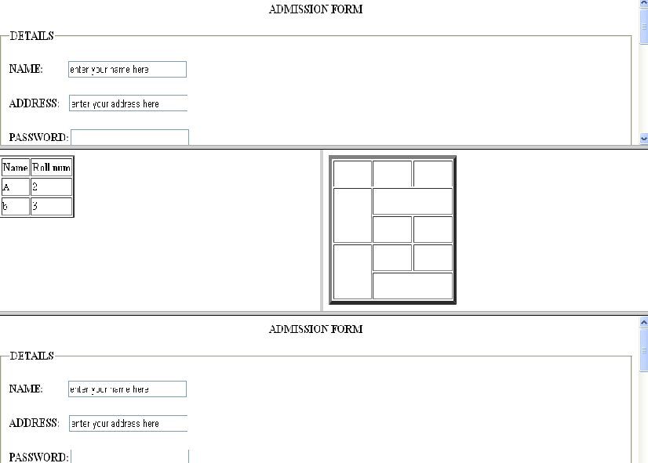

Slide 47
BORDER
If value id set to 0 then frame will be without border.
If value is some positive number then the border size will increase as per the value.
<html>
<head><title> FRAMING TAGS</title></head>
<frameset border=0 rows="200,*,*">
<frame src="form.html">
<frameset cols="*,*">
<frame src="1.html">
<frame src="table.html">
</frameset>
<frame src="form.html">
</frameset>
</html>

Slide 48
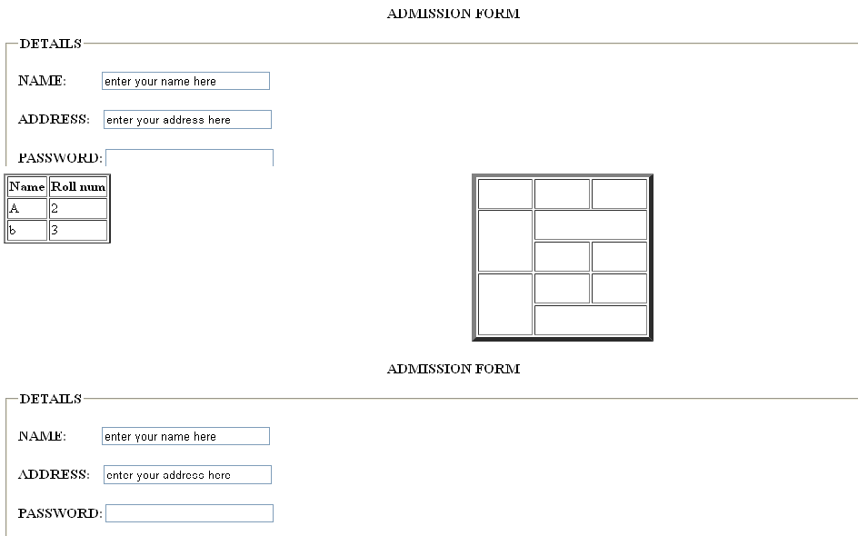

Slide 49
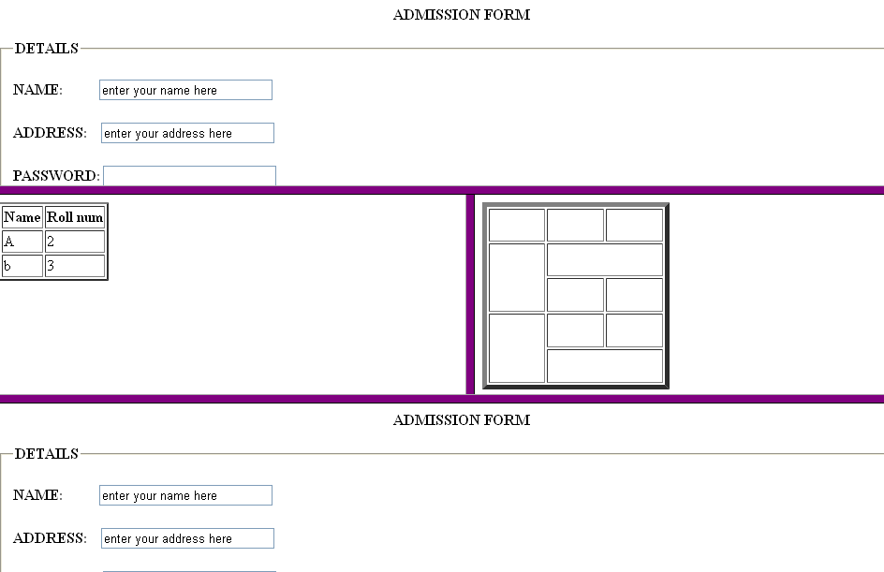
BORDER COLOR= purple

Slide 50
HTML iframe
The iframe HTML tag is used to specify the URL of the document to be embedded.
Iframes are often used to embed videos, maps, and other media on a web page. You can also use them to embed another web page into a web page. Here are a few examples of code using iframe to embed an external resource:
<iframe src="http://www.example.com/">
<iframe src="http://www.example.com/" width="400" height="300">
<iframe src="http://www.example.com/" style="border: 0;">

Slide 51
HTML Multimedia
What is Multimedia?
Multimedia comes in many different formats. It can be almost anything you can hear or see, like images, music, sound, videos, records, films, animations, and more.
Web pages often contain multimedia elements of different types and formats.
Browser Support
The first web browsers had support for text only, limited to a single font in a single color.
Later came browsers with support for colors, fonts, images, and multimedia!
Multimedia Formats
Multimedia elements (like audio or video) are stored in media files.
The most common way to discover the type of a file, is to look at the file extension.
Multimedia files have formats and different extensions like: .wav, .mp3, .mp4, .mpg, .wmv, and .avi.

Slide 52
Media Tags:
<audio>: It is an inline element that is used to embed sound files into a web page.
<video>: It is used to embed video files into a web page.
<source>: It is used to attach multimedia files like audio, video, and pictures.
<embed>: It is used for embedding external applications which are generally multimedia content like audio or video into an HTML document.
<track>: It specifies text tracks for media components audio and video.
Advantage of Media tag:
Plugins are no longer required
Speed – anything naturally integrated into a browser will be rendered and executed in a faster fashion than imported third-party.
Native (built-in) controls are provided by the browser.
Accessibilities (keyboard, mouse) are built-in automatically.

Slide 53
HTML Video
Common Video Formats:
There are many video formats out there.
The MP4, WebM, and Ogg formats are supported by HTML.
The MP4 format is recommended by YouTube.
The HTML <video> element is used to show a video on a web page.
Format | File | Description
MPEG | .mpg .mpeg | MPEG. Developed by the Moving Pictures Expert Group. The first popular video format on the web. Not supported anymore in HTML.
AVI | .avi | AVI (Audio Video Interleave). Developed by Microsoft. Commonly used in video cameras and TV hardware. Plays well on Windows computers, but not in web browsers.
WMV | .wmv | WMV (Windows Media Video). Developed by Microsoft. Commonly used in video cameras and TV hardware. Plays well on Windows computers, but not in web browsers.
QuickTime | .mov | QuickTime. Developed by Apple. Commonly used in video cameras and TV hardware. Plays well on Apple computers, but not in web browsers.
RealVideo | .rm .ram | RealVideo. Developed by Real Media to allow video streaming with low bandwidths. Does not play in web browsers.
Flash | .swf .flv | Flash. Developed by Macromedia. Often requires an extra component (plug-in) to play in web browsers.
Ogg | .ogg | Theora Ogg. Developed by the Xiph.Org Foundation. Supported by HTML.
WebM | .webm | WebM. Developed by Mozilla, Opera, Adobe, and Google. Supported by HTML.
MPEG-4 or MP4 | .mp4 | MP4. Developed by the Moving Pictures Expert Group. Commonly used in video cameras and TV hardware. Supported by all browsers and recommended by YouTube.

Slide 54
Syntax:
The controls attribute adds video controls, like play, pause, and volume.
To start an audio file automatically, use the autoplay attribute.
Add muted after autoplay to let your audio file start playing automatically (but muted).
It is a good idea to always include width and height attributes. If height and width are not set, the page might flicker while the video loads.
The <source> element allows you to specify alternative video files which the browser may choose from. The browser will use the first recognized format.
The text between the <video> and </video> tags will only be displayed in browsers that do not support the <video> element.
<video width="320" height="240" controls autoplay muted > <source src="movie.mp4" type="video/mp4">
<source src="movie.ogg" type="video/ogg">
<source src="movie. webm" type="video/webm"> </video>

Slide 55
Syntax:
HTML Audio
The HTML <audio> element is used to play an audio file on a web page.
The controls attribute adds audio controls, like play, pause, and volume.
Using the loop attribute will make the audio file play over and over again
To start an audio file automatically, use the autoplay attribute.
Add muted after autoplay to let your audio file start playing automatically (but muted).
The <source> element allows you to specify alternative audio files which the browser may choose from. The browser will use the first recognized format.
The text between the <audio> and </audio> tags will only be displayed in browsers that do not support the <audio> element
<audio autoplay controls loop muted> <source src="horse.ogg" type="audio/ogg"> <source src="horse.mp3" type="audio/mpeg">
<source src="horse.wav" type="audio/wav"> Your browser does not support the audio element. </audio>

Slide 56
HTML YouTube Videos
The easiest way to play videos in HTML, is to use YouTube.
Playing a YouTube Video in HTML
To play your video on a web page, do the following:
Upload the video to YouTube
Take a note of the video id
Define an <iframe> element in your web page
Let the src attribute point to the video URL
Use the width and height attributes to specify the dimension of the player
YouTube Autoplay + Mute
You can let your video start playing automatically when a user visits the page, by adding autoplay=1 to the YouTube URL.
Add mute=1 after autoplay=1 to let your video start playing automatically (but muted).

Slide 57
YouTube Controls
Add controls=0 to not display controls in the video player.
Value 0: Player controls does not display.
Value 1 (default): Player controls display.
YouTube Loop
Add loop=1 to let your video loop forever.
Value 0 (default): The video will play only once.
Value 1: The video will loop (forever).
<iframe width="420" height="345" src="https://www.youtube.com/embed/tgbNymZ7vqY?&loop=1&controls=1&autoplay=1&mute=1">
</iframe>

Slide 58
HTML SVG Graphics
SVG stands for Scalable Vector Graphics
SVG is used to define vector-based graphics for the Web
SVG defines the graphics in XML format
Every element and every attribute in SVG files can be animated
SVG is a W3C recommendation
SVG integrates with other W3C standards such as the DOM and XSL
SVG is a W3C Recommendation
SVG 1.0 became a W3C Recommendation on 4 September 2001.
SVG 1.1 became a W3C Recommendation on 14 January 2003.
SVG 1.1 (Second Edition) became a W3C Recommendation on 16 August 2011.
SVG Advantages
Advantages of using SVG over other image formats (like JPEG and GIF) are:
SVG images can be created and edited with any text editor
SVG images can be searched, indexed, scripted, and compressed
SVG images are scalable
SVG images can be printed with high quality at any resolution
SVG images are zoomable
SVG graphics do NOT lose any quality if they are zoomed or resized
SVG is an open standard
SVG files are pure XML

Slide 59
The HTML <svg> Element
The HTML <svg> element is a container for SVG graphics.
SVG has several methods for drawing paths, boxes, circles, text, and graphic images.
SVG Shapes
SVG has some predefined shape elements that can be used by developers:
Rectangle <rect>
Circle <circle>
Ellipse <ellipse>
Line <line>
Polyline <polyline>
Polygon <polygon>
Text<text>
<svg width="100" height="100"> <circle cx="50" cy="50" r="40" stroke="green" stroke-width="4" fill="yellow" /> </svg>

Slide 60

SVG Rectangle - <rect>
Example:
The <rect> element is used to create a rectangle and variations of a rectangle shape.
<svg width="400" height="180"> <rect x="50" y="20" width="150" height="150" style="fill:blue;stroke:pink;stroke-width:5;fill-opacity:0.1;stroke-opacity:0.9" /> </svg>
Code explanation:
The x attribute defines the left position of the rectangle (e.g. x="50" places the rectangle 50 px from the left margin)
The y attribute defines the top position of the rectangle (e.g. y="20" places the rectangle 20 px from the top margin)
The CSS fill-opacity property defines the opacity of the fill color (legal range: 0 to 1)
The CSS stroke-opacity property defines the opacity of the stroke color (legal range: 0 to 1)

Slide 61
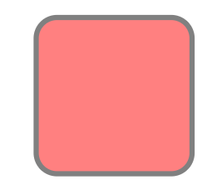
SVG Rounded Rectangle - <rect>
<svg width="400" height="180"> <rect x="50" y="20" rx="20" ry="20" width="150" height="150" style="fill:red;stroke:black;stroke-width:5;opacity:0.5" /> </svg>
Code explanation:
The rx and the ry attributes rounds the corners of the rectangle

Slide 62
SVG Circle - <circle>
The <circle> element is used to create a circle:
<svg height="100" width="100"> <circle cx="50" cy="50" r="40" stroke="black" stroke-width="3" fill="red" /> </svg>
Code explanation:
The cx and cy attributes define the x and y coordinates of the center of the circle. If cx and cy are omitted, the circle's center is set to (0,0)
The r attribute defines the radius of the circle

Slide 63
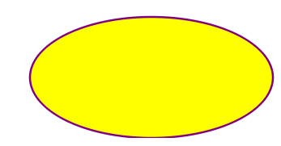
SVG Ellipse - <ellipse>
The <ellipse> element is used to create an ellipse.
An ellipse is closely related to a circle. The difference is that an ellipse has an x and a y radius that differs from each other, while a circle has equal x and y radius:
<svg height="140" width="500"> <ellipse cx="200" cy="80" rx="100" ry="50“ style="fill:yellow;stroke:purple;stroke-width:2" /> </svg>
Code explanation:
The cx attribute defines the x coordinate of the center of the ellipse
The cy attribute defines the y coordinate of the center of the ellipse
The rx attribute defines the horizontal radius
The ry attribute defines the vertical radius

Slide 64
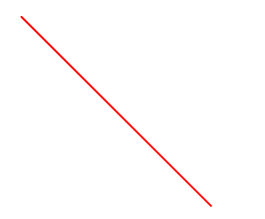
SVG Line - <line>
The <line> element is used to create a line:
<svg height="210" width="500"> <line x1="0" y1="0" x2="200" y2="200" style="stroke:rgb(255,0,0);stroke-width:2" /> </svg>
Code explanation:
The x1 attribute defines the start of the line on the x-axis
The y1 attribute defines the start of the line on the y-axis
The x2 attribute defines the end of the line on the x-axis
The y2 attribute defines the end of the line on the y-axis

Slide 65
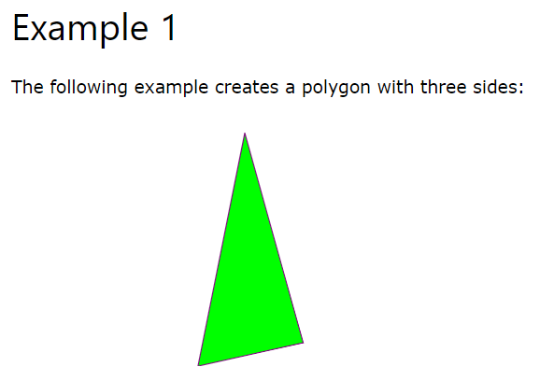
SVG Polygon - <polygon>
The <polygon> element is used to create a graphic that contains at least three sides.
Polygons are made of straight lines, and the shape is "closed" (all the lines connect up).
Polygon comes from Greek. "Poly" means "many" and "gon" means "angle".
<svg height="210" width="500"> <polygon points="200,10,250,190 160,210" style="fill:lime;stroke:purple;stroke-width:1" /> </svg>
Code explanation:
The points attribute defines the x and y coordinates for each corner of the polygon

Slide 66
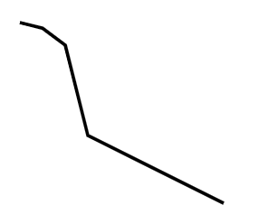
SVG Polyline - <polyline>
The <polyline> element is used to create any shape that consists of only straight lines (that is connected at several points):
<svg height="200" width="500"> <polyline points="20,20 40,25 60,40 80,120 120,140 200,180" style="fill:none;stroke:black;stroke-width:3" /> </svg>
Code explanation:
The points attribute defines the list of points (pairs of x and y coordinates) required to draw the polyline

Slide 67
SVG Text - <text>
The <text> element is used to define a text.
<svg height="30" width="200"> <text x="0" y="15" fill="red">I love SVG!</text> </svg>
I love SVG!
Rotate the text:
<svg height="60" width="200"> <text x="0" y="15" fill="red" transform="rotate(30 20,40)">I love SVG</text> </svg>
I love SVG!
I love SVG
Text as a link (with the <a> element):
<svg height="30" width="200" > <a href="https://www.w3schools.com/graphics/" target="_blank"> <text x="0" y="15" fill="red">I love SVG!</text> </a> </svg>
I love SVG!

Slide 68
Thank You

